Slide 1

AI-Powered News Categorization, Summarization, and Multilingual Recommendation System Using Natural Language Processing
DSA0307 – Natural Language Processing
Guided By:
Dr. Anbazhagan. K
PRESENTED BY:
S. Sahithya (192472186)
S. Sri Sai Prasanna Durga (192424241)
C. Ishwarya (192472108)
C. Nithisha (192424375)

Slide 2



INTRODUCTION
News is generated in large amounts every day from different sources and platforms.
Finding relevant information from a large number of news articles can be time-consuming.
Natural Language Processing (NLP) helps computers to understand and process human language.
This project uses AI and NLP to categorize news, generate summaries, and recommend relevant articles.
The system also supports multiple languages to provide a better and personalized news reading experience.

Slide 3
PROBLEM STATEMENT
The huge amount of daily news makes it difficult for users to find relevant information.
Manually reading long news articles requires more time and effort.
News articles are available in different categories and languages, making organization difficult.
Users may struggle to identify the most important information from lengthy articles.
Existing news platforms may not provide personalized recommendations based on user interests.
Therefore, an AI and NLP-based system is needed to categorize, summarize, and recommend relevant news in multiple languages.

Slide 4
LITERATURE REVIEW
S.No. | Author & Year | Research Focus | Key Finding
1 | Ren & Xie (2026) | Personalized news recommendation | Multi-task learning improves personalized recommendations.
2 | Rani Krishna et al. (2025) | News text summarization | Deep learning models can generate concise and informative news summaries.
3 | Zhang et al. (2024) | LLM-based news summarization | LLMs show strong potential for automatic news summarization.
4 | Kannen et al. (2024) | News recommendation | Learning-to-rank methods improve personalized news ranking.
5 | Li et al. (2023) | ChatGPT for news recommendation | Fine-tuned ChatGPT can improve personalized news recommendations.

Slide 5

OBJECTIVES
To collect and preprocess news articles using Natural Language Processing (NLP) techniques.
To automatically categorize news articles into different topics using AI and NLP techniques.
To generate short and meaningful summaries from lengthy news articles.
To support multilingual news processing for different languages.
To provide personalized news recommendations based on user interests.
To develop a user-friendly system for quick and efficient access to relevant news.

Slide 6
PROPOSED SYSTEM
It uses Artificial Intelligence and Natural Language Processing (NLP) to process and understand news articles.
News articles are first collected and pre processed to remove unwanted content and prepare the text for analysis.
An AI-based model categorizes news articles into different topics such as Sports, Politics, Technology, and Business.
The system generates short and meaningful summaries from lengthy news articles.
It supports multiple languages and recommends relevant news based on user interests and reading preferences.
The system provides a personalized and efficient news reading experience.

Slide 7
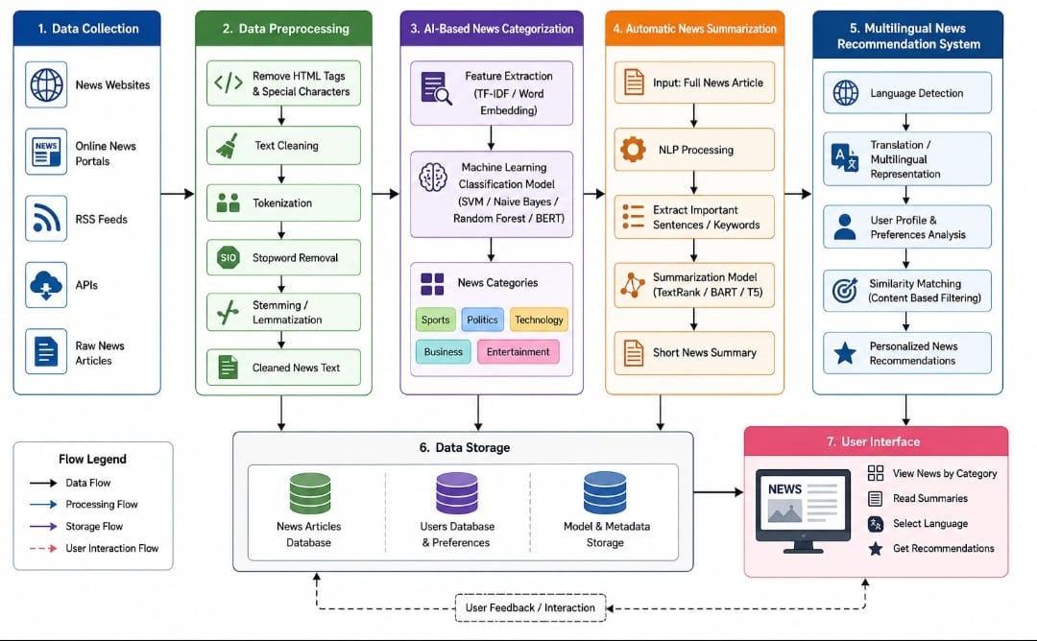
SYSTEM ARCHITECTURE

Slide 8
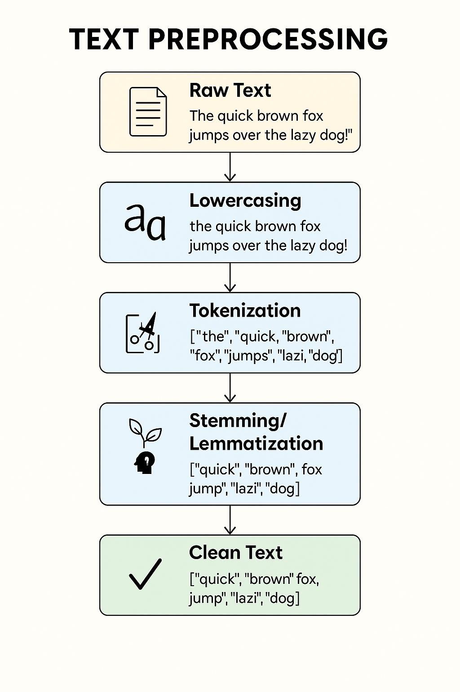
Module 1: News Data Collection and Text Preprocessing
Collect news articles from different datasets or online sources.
Clean the collected news by removing unwanted symbols, special characters, and duplicate content.
Perform tokenization to divide the news into words or sentences.
Remove stop words that do not contribute much to the meaning.
Apply stemming or lemmatization to normalize the words.
Prepare the cleaned text for news categorization, summarization, and recommendation.

Slide 9
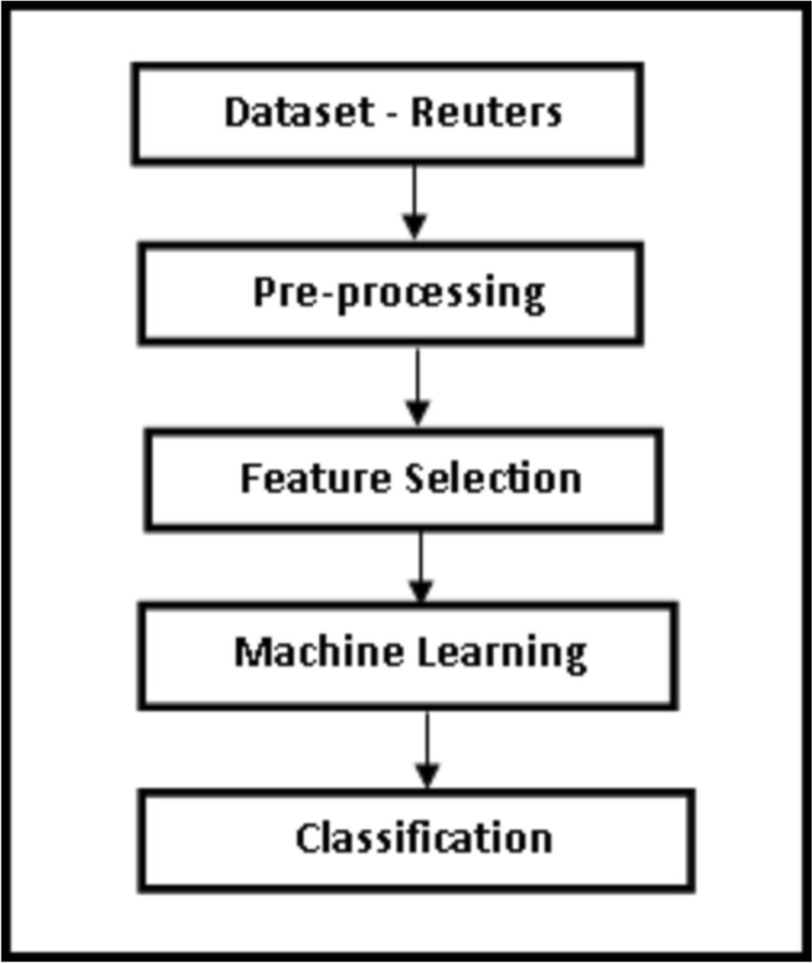
Module 2: AI-Based News Categorization
Analyse the pre processed news articles using NLP and machine learning techniques.
Extract important text features to understand the content of each news article.
Train an AI-based classification model using the prepared news dataset.
Automatically classify news into categories such as Sports, Politics, Technology, Business, and Entertainment.
Predict the category of new or unseen news articles and display the result to the user.

Slide 10
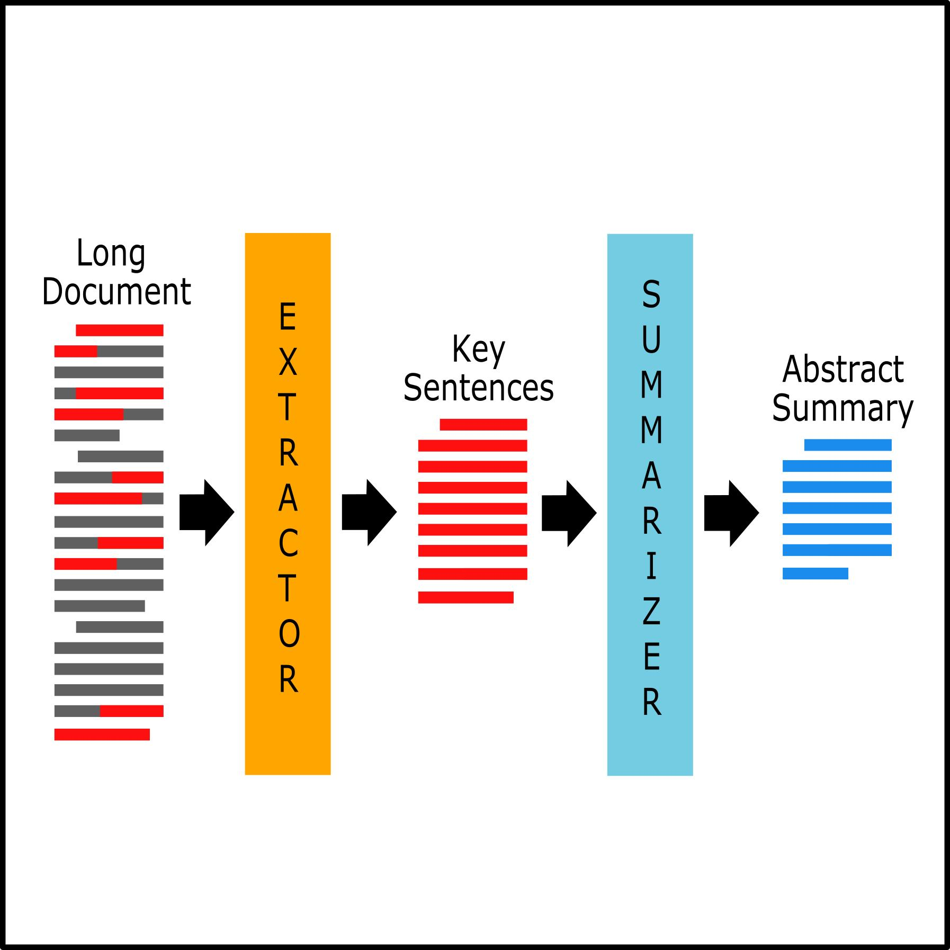
Module 3: Automatic News Summarization
Process lengthy news articles using Natural Language Processing techniques.
Identify the important information and key sentences from the article.
Generate a concise and meaningful summary while preserving the main ideas.
Remove unnecessary and repetitive information from the original article.
Provide users with a quick and easy way to understand lengthy news articles.

Slide 11

Module 4: Multilingual News Recommendation System
Process news articles in multiple languages using NLP techniques.
Identify the language and meaning of news content across different languages.
Analyze user interests and reading preferences to understand their information needs.
Find similar and relevant news articles based on the user's interests.
Recommend personalized news in the user's preferred language.
Help users discover relevant news quickly, regardless of language.

Slide 12
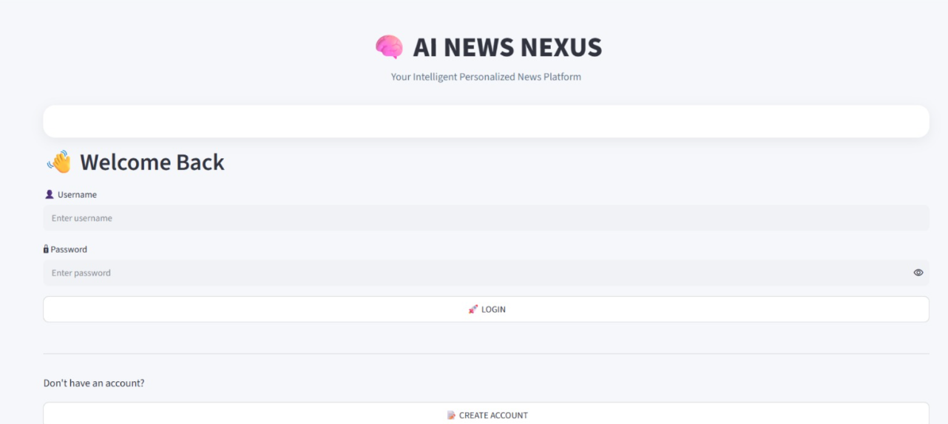
IMPLEMENTATION

Slide 13
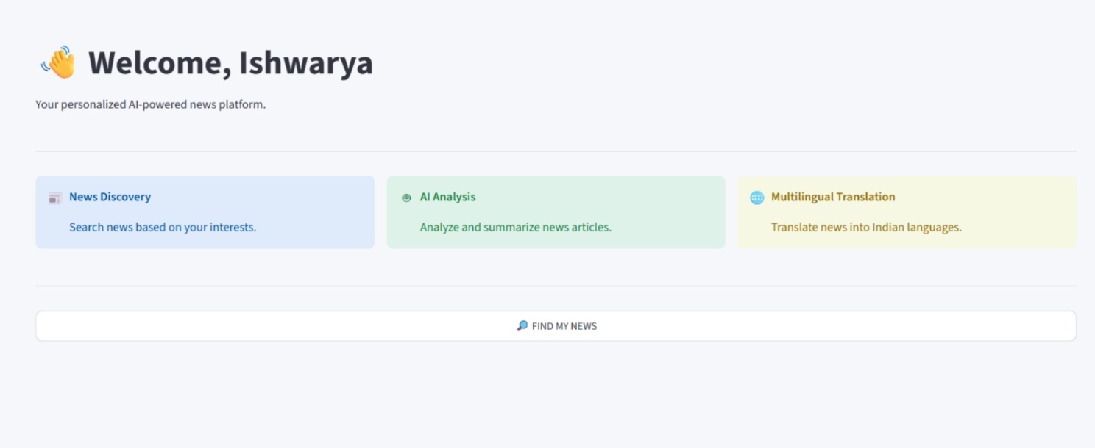

Slide 14
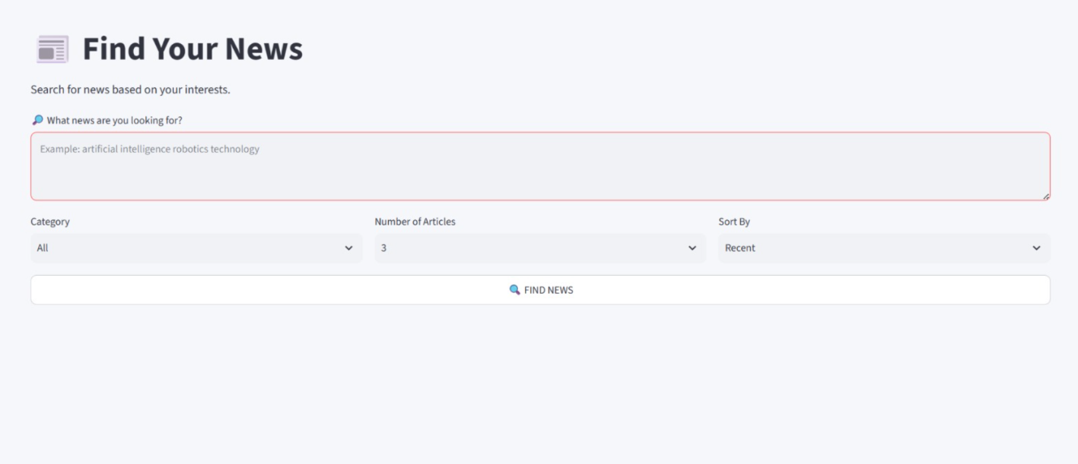

Slide 15
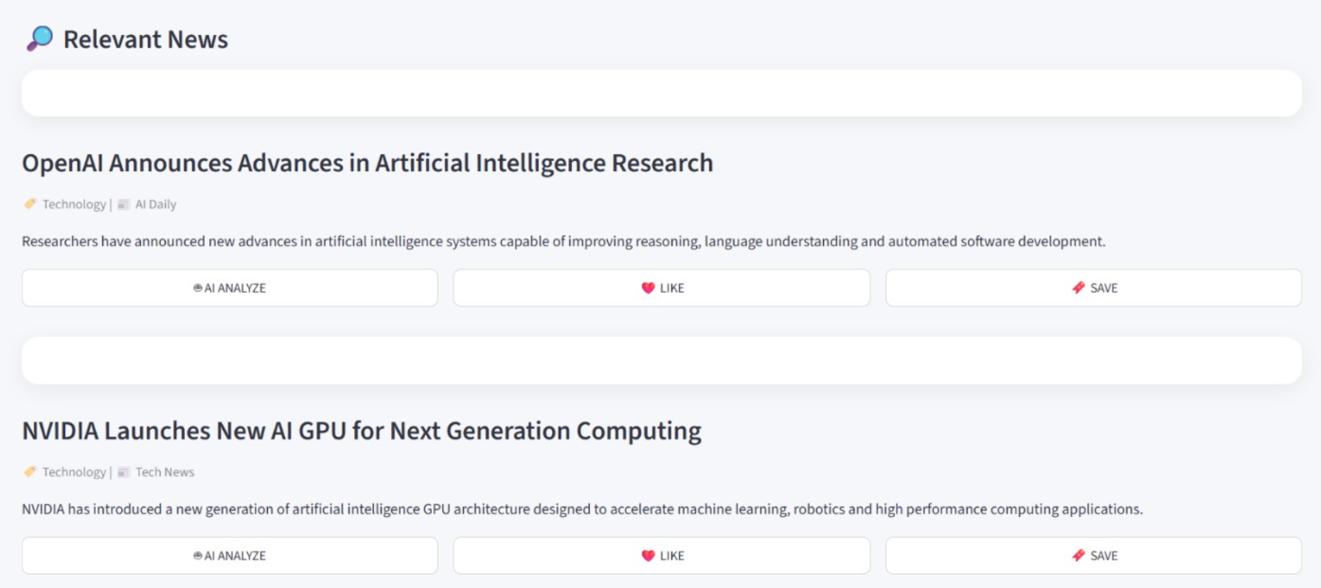

Slide 16
RESULTS AND DISCUSSION
The system is designed to automatically classify news articles into categories such as Sports, Politics, Technology, Business, and Entertainment.
The summarization module generates short and meaningful summaries from lengthy news articles.
Multilingual processing enables the system to handle news content in different languages.
The recommendation module provides relevant news based on user interests and preferences.
The combined modules provide a faster and more personalized way of accessing news information.
Recent research also shows that multilingual recommendation and NLP-based summarization are active areas of development, supporting the relevance of the proposed approach.

Slide 17
CONCLUSION
The proposed system uses AI and Natural Language Processing to efficiently process and manage news articles.
It automatically categorizes news into different topics and generates short, meaningful summaries.
The multilingual feature helps users access and understand news in different languages.
The recommendation system provides personalized news based on user interests.
Overall, the system helps users save time, find relevant information, and improve their news reading experience.

Slide 18
FUTURE SCOPE
The system can be extended to support more regional and international languages.
Advanced AI and deep learning models can be used to improve news categorization and summarization.
Real-time news collection can be integrated to provide the latest news updates.
The recommendation system can be improved using advanced user behavior and preference analysis.
A mobile application can be developed for easier access to personalized news.
The system can be enhanced to identify fake news and misleading information in the future.

Slide 19


